Slide 1
Discrete Math- Greatest Common Divisor
Mario Acevedo Jimenez

Slide 2
What is the “Greatest Common Divisor”?
Let's start by defining the Greatest Common Divisor also known as the GCD. The GCD of two integers is the largest positive integer that divides two integers without leaving a remainder.

Slide 3
What is the notation used for the Greatest Common Divisor?
We often use the notation GCD(a, b) to represent the greatest common divisor of integers a and b.

Slide 4
Let’s look at some examples
Consider two numbers, 24 and 36. What would the GCD of 24 and 36 be? GCD(24,36)
You can pause the video and try this at home to see if you can figure this out or continue on to learn a few methods to calculate this.

Slide 5
Finding the GCD – The long way
One way of finding the GCD is to list the factors of each number.
For 24, the factors are 1, 2, 3, 4, 6, 8, 12, and 24. For 36, the factors are 1, 2, 3, 4, 6, 9, 12, 18, and 36
From doing this, we can see that the common factors are 1, 2, 3, 4, 6, and 12. Among these, 12 is the largest.
This means that the GCD(24, 36) is 12.
This method can be time consuming and repetitive. Sometimes we’ll have two numbers that are too large to factor out in a reasonable time.

Slide 6
The Euclidean Algorithm
The Euclidean Algorithm is a more efficient method for finding the GCD. It is based on the observation that the GCD of two given numbers is the same as the GCD of the smaller number and the remainder of dividing the larger number by the smaller number
Algorithm Steps
1. Find the maximum number of times the smaller number fits into the larger number. The remainder is what will be used for step 2.
2. The remainder will be used to divide our previous divisor from step 1.
3. Repeat until the remainder is 0. The GCD is the last non-zero remainder.

Slide 7
Let’s use the Euclidean Algorithm to find the GCD(48,18).
The following format allows for easier calculation and makes the algorithm easier to read and follow.
Step 1: Find the maximum number of times 18 fits into 48. We find that 18 fits into 48 two times with a remainder of 12. The remainder is what will be used for step 2.
48 = 18(2) + R = 12
Step 2: Our previous divisor of 18 will be divided by the remainder from our previous step until we reach a remainder of 0.
18 = 12(1) + R = 6
Step 3: As we do not yet have a remainder of 0 we repeat step 2.
12 = 6(2) + R = 0
We now have a remainder of 0 which means our last non-zero remainder of 6 is our GCD.

Slide 8
Greatest Common Divisor – Fundamental Theorem of Arithmetic
The Fundamental Theorem of Arithmetic states that every positive integer greater than 1 can be expressed uniquely as a product of prime numbers.

Slide 9
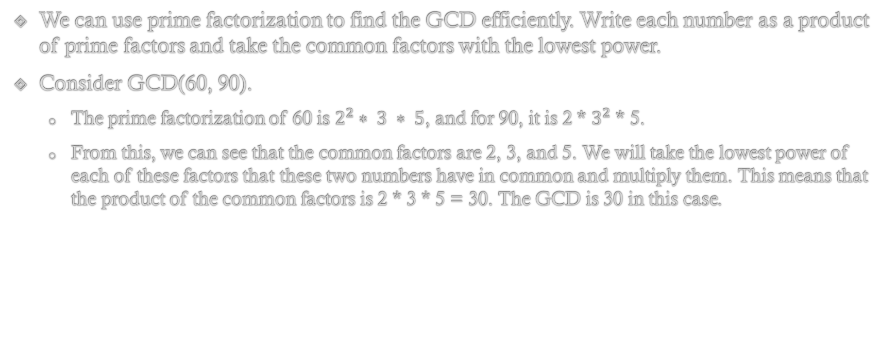
Greatest Common Divisor-Using Prime Factorization
We can use prime factorization to find the GCD efficiently. Write each number as a product of prime factors and take the common factors with the lowest power.
Consider GCD(60, 90).
The prime factorization of 60 is $2^{2}∗ 3 ∗ 5$, and for 90, it is 2 * $3^{2}$ * 5.
From this, we can see that the common factors are 2, 3, and 5. We will take the lowest power of each of these factors that these two numbers have in common and multiply them. This means that the product of the common factors is 2 * 3 * 5 = 30. The GCD is 30 in this case.

Slide 10
Greatest Common Divisor - Recap
To recap, we explored the definition of the Greatest Common Divisor, learned how to find it using the basic factoring method and the Euclidean Algorithm. We also saw how prime factorization can be used for efficient calculations.
Understanding the GCD is crucial in various areas of discrete mathematics and computer science, including number theory, cryptography, and algorithm design.

